Slide 1

COMP-112 • OOP PROJECT
TITAN TRACK
A Secure, Offline Fitness Ecosystem using C++11, OOP, Local Persistence, and Validation-Centric Design
Presented by Zarak Khan Afridi — B25F0485CYD123 Amar Sadat — B25F2099CYS127 BS Cybersecurity (2nd Semester) Pak-Austria Fachhochschule: Institute of Applied Sciences and Technology Evaluator: Mr. Aadil Khan

Slide 2
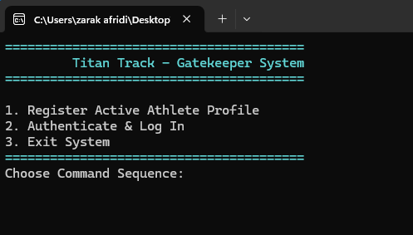
Gatekeeper System • Main Login / Entry Menu
100% OFFLINE
LOCAL PERSISTENCE
User selects Register, Authenticate & Log In, or Exit

Slide 3
Architectural Problem Domain
Why basic terminal trackers fail
Many beginner console applications keep all runtime state in volatile memory, so data disappears as soon as the terminal process ends.
That means users lose accounts, workout records, and continuity of progress — which directly defeats the purpose of a tracking system.
A second weakness is spaghetti procedural code, where menus, parsing, validation, and file operations are tightly coupled in one fragile control flow.
Titan Track solves this by separating validation logic, user models, workout models, menu behavior, and storage mechanics into cleaner OOP layers.
Titan Track Response
Persistent local storage
Validation-gated registration
User session isolation
Polymorphic workout handling
Cleaner testability and maintainability
FROM VOLATILE TO PERSISTENT
Titan Track Final Defense • Zarak Khan Afridi (B25F0485CYD123) • Amar Sadat (B25F2099CYS127)

Slide 4
Environment Constraints & Specifications
Designed for classroom portability, low disk cost, and strict privacy through full offline execution.
Hardware Baseline
x86/x64 compatible
Under 5 MB storage footprint
Lab-machine friendly
Software Stack
Windows 10/11 console
ISO C++11 codebase
MinGW-w64 GCC compilation
Privacy Significance
100% offline workflow
No cloud dependency
No third-party database
Titan Track Final Defense • Zarak Khan Afridi (B25F0485CYD123) • Amar Sadat (B25F2099CYS127)

Slide 5
Blueprint of the Four OOP Pillars
Encapsulation
Sensitive credentials stay behind protected/private bounds, and updates occur only through validation-controlled methods.
Inheritance
TitanUser extends the base User class, reusing identity logic while adding workout-specific state.
Polymorphism
Different workout behaviors and menu flows are routed through flexible interfaces and override-capable design.
Abstraction
StorageManager hides raw file stream handling behind clear methods so the rest of the app stays cleaner and safer.
Titan Track Final Defense • Zarak Khan Afridi (B25F0485CYD123) • Amar Sadat (B25F2099CYS127)

Slide 6
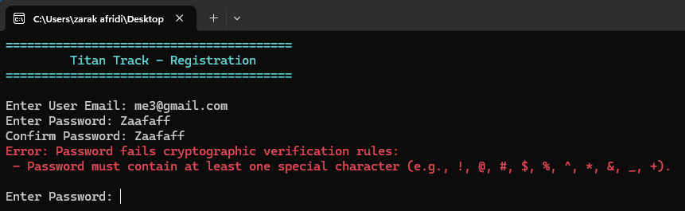
The Authentication Gatekeeper
Registration Validation in Action
The registration layer blocks invalid user records before anything is persisted.
Email logic checks the presence and structure of the @ symbol and valid extension placement.
Password rules enforce minimum length and require uppercase, lowercase, and special-symbol presence.
The screenshot shows a live rejection case triggered by weak password composition.
Weak Password Rejected
Special-character requirement failed during registration
Titan Track Final Defense • Zarak Khan Afridi (B25F0485CYD123) • Amar Sadat (B25F2099CYS127)

Slide 7
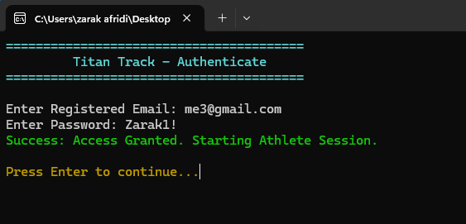
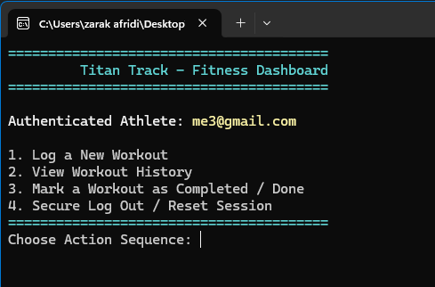
Authentication Success & Session Launch
Verified Session Entry
After valid registration, the user authenticates using the stored email and password pair.
A successful match transitions the execution context into the athlete session.
This confirms the cooperation between validation, persistence, and login flow.
Login Success
Dashboard Loaded
Access granted and athlete session started
Authenticated athlete menu
Titan Track Final Defense • Zarak Khan Afridi (B25F0485CYD123) • Amar Sadat (B25F2099CYS127)

Slide 8
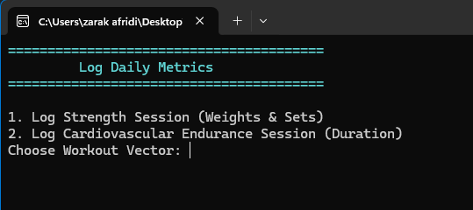
User Dashboard & Workout Logging Workspace
State Isolation + Activity Routing
Once authenticated, actions operate only inside the active athlete context. Users can log workouts, inspect history, mark completion, or securely terminate the session.
Main Dashboard
Log Daily Metrics
Menu options for log, history, completion, and logout
Choose Strength or Cardio vector
Titan Track Final Defense • Zarak Khan Afridi (B25F0485CYD123) • Amar Sadat (B25F2099CYS127)

Slide 9
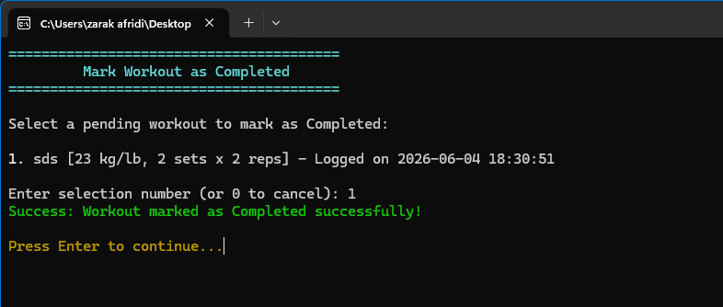
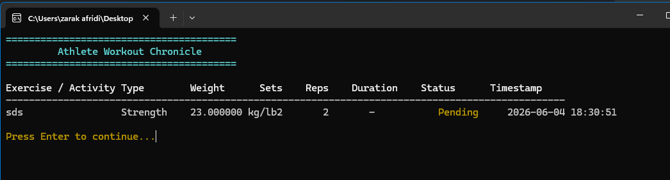
Workout Chronicle & Completion Lifecycle
Persistent Record Evolution
Titan Track persists workout metadata such as type, weight, sets, reps, status, and timestamp. A pending workout can later be mutated into a completed state without leaving the local workflow.
Workout Chronicle / Pending Status
Mark Workout as Completed
Chronicle view shows saved exercise state and timestamp
Pending workout successfully updated to completed
Titan Track Final Defense • Zarak Khan Afridi (B25F0485CYD123) • Amar Sadat (B25F2099CYS127)

Slide 10
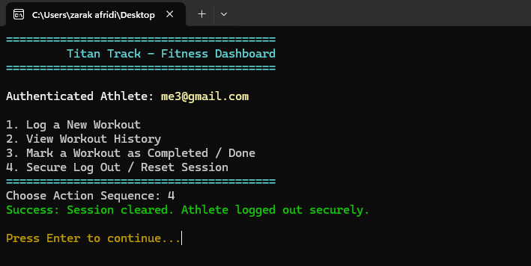
Secure Logout & Session Reset
Why Logout Matters
Titan Track does not just enter sessions safely — it also exits them safely.
The logout sequence clears the current athlete context to avoid accidental carryover into the next interaction cycle.
This is important for multi-user classroom demonstrations and aligns with secure state-management principles.
Secure Session Termination
Session cleared and athlete logged out securely
Titan Track Final Defense • Zarak Khan Afridi (B25F0485CYD123) • Amar Sadat (B25F2099CYS127)

Slide 11
Local Persistence Architecture
Flat-File Database Model
Titan Track uses <fstream> to store credentials and workout records in local text files such as users.txt and workouts.txt.
At write time, runtime objects are serialized into comma-delimited strings. On startup, std::stringstream tokenizes lines back into usable values.
This gives the project true persistence without introducing external libraries or cloud infrastructure.
Runtime Objects
Serialize → File
Read → Tokenize → Restore
Titan Track Final Defense • Zarak Khan Afridi (B25F0485CYD123) • Amar Sadat (B25F2099CYS127)

Slide 12
Source Code Implementation Blueprint
class View { public: virtual void displayMenu() = 0; }; class User { protected: string email, password; }; class TitanUser : public User { private: vector<Workout> logs; }; class StorageManager { public: bool saveUser(const TitanUser& u); vector<Workout> loadWorkouts(const string& email);}

Slide 13
Quality Assurance, Limitations & Key Takeaways
Validation & Testing Mindset
A separate test.cpp pathway can validate email rules, password strength logic, login behavior, and workflow correctness.
Live screenshots support the defense by proving that the implemented logic is visible and operational in the terminal interface.
Current Limitations
Flat-file parsing scales linearly as record counts grow.
Plaintext-oriented local storage should evolve toward hashing and more structured indexing.
Future Upgrades
Upgrade persistence to SQLite for better indexing and scalability.
Add SHA-256 password hashing and stronger defensive error handling.
Extend dashboard analytics and richer unit-test coverage.
Titan Track Final Defense • Zarak Khan Afridi (B25F0485CYD123) • Amar Sadat (B25F2099CYS127)

Slide 14
QUESTIONS & ANSWERS
Thank you for your time and consideration!
Evaluator: Mr. Aadil Khan
Developers: Zarak Khan Afridi (B25F0485CYD123) • Amar Sadat (B25F2099CYS127)
Titan Track Final Defense • Zarak Khan Afridi (B25F0485CYD123) • Amar Sadat (B25F2099CYS127)

